Slide 1
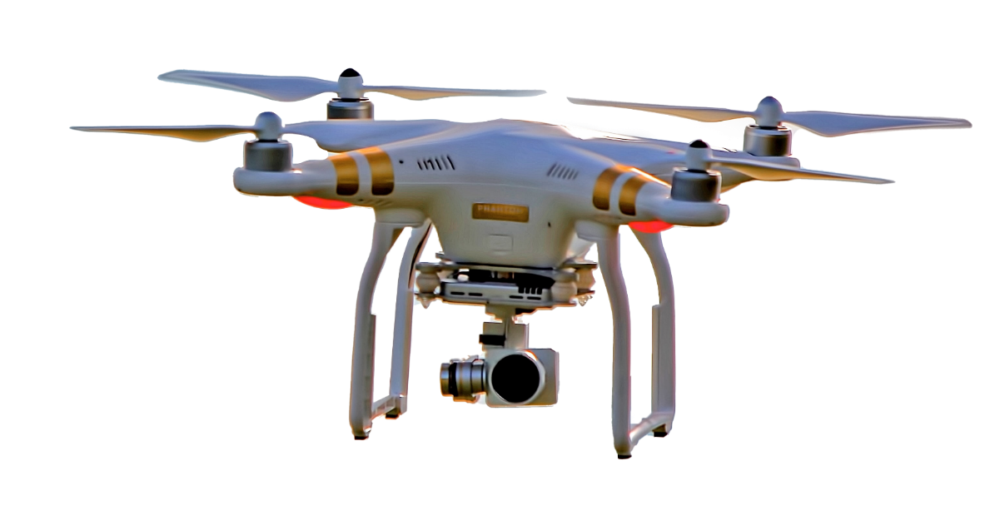
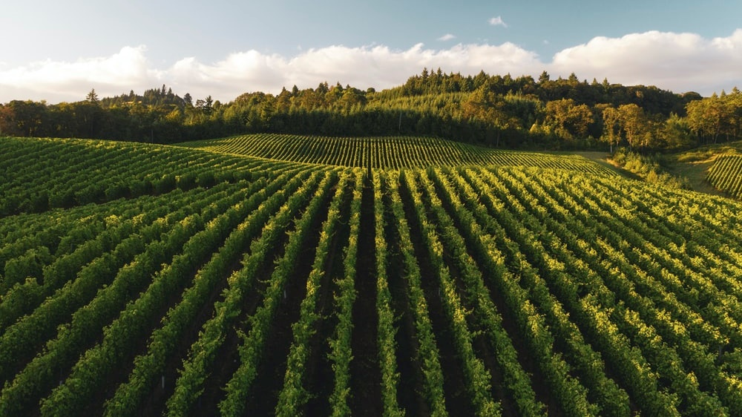
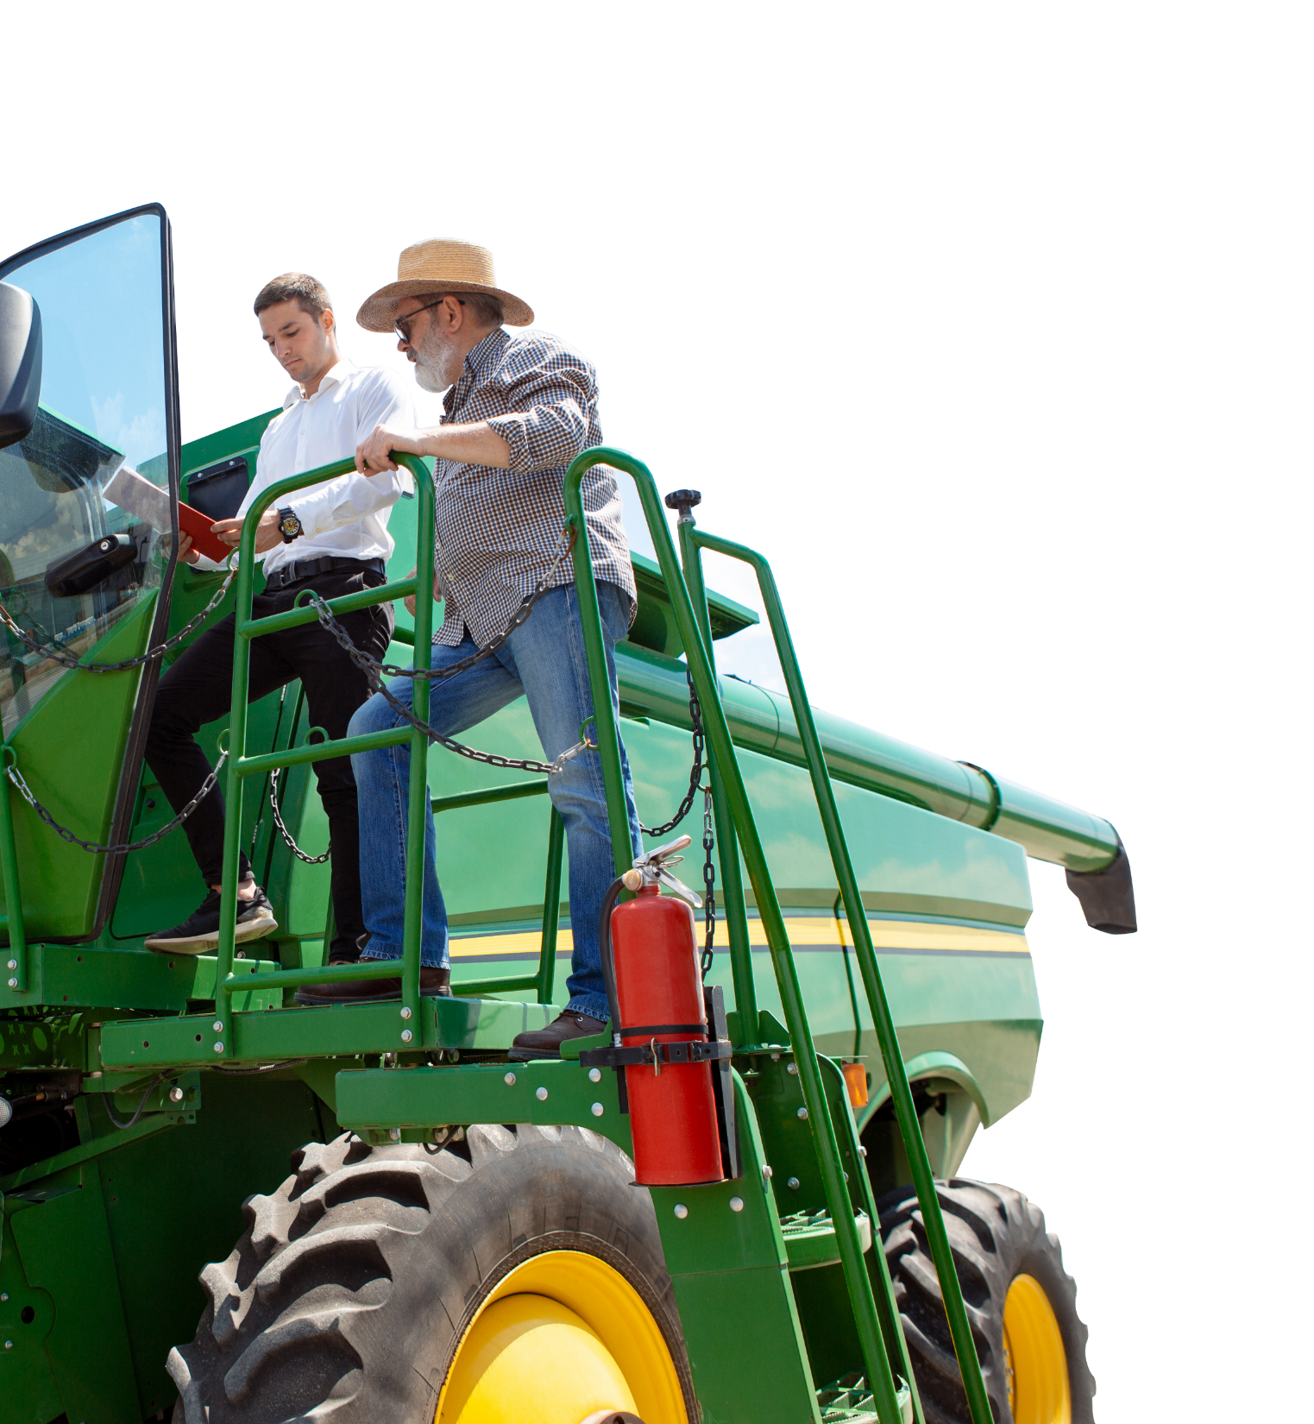
SMART Agricultural Digital Library
The agricultural sector is a cornerstone of Egypt's economy, playing a vital role in food supply, employment, and national food security
Notes:
https://unsplash.com/photos/d7CZYeWZyzc
<a href='https://www.freepik.com/photos/agriculture-tractor'>Agriculture tractor photo created by master1305 - www.freepik.com</a>

Slide 2
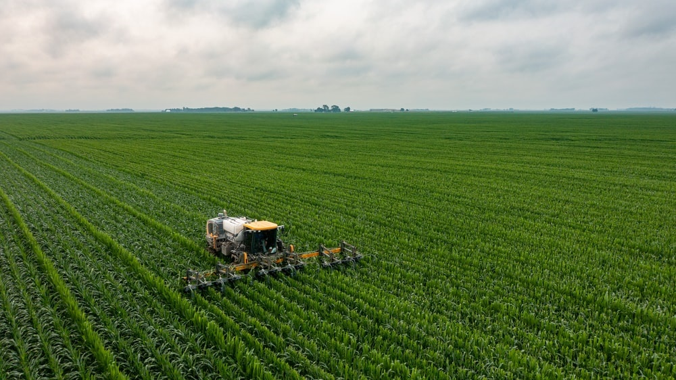
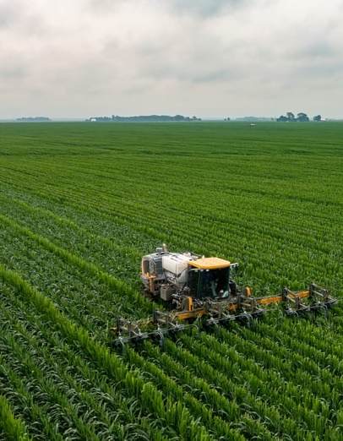

Green stone
01
01
02
AGENDA
03
04
Main components.
Build Success.
Preview In Browser.
05
06
07
08
Notes:
https://unsplash.com/photos/YbBWmI4hZys
https://unsplash.com/photos/unuTn05q0nk

Slide 3
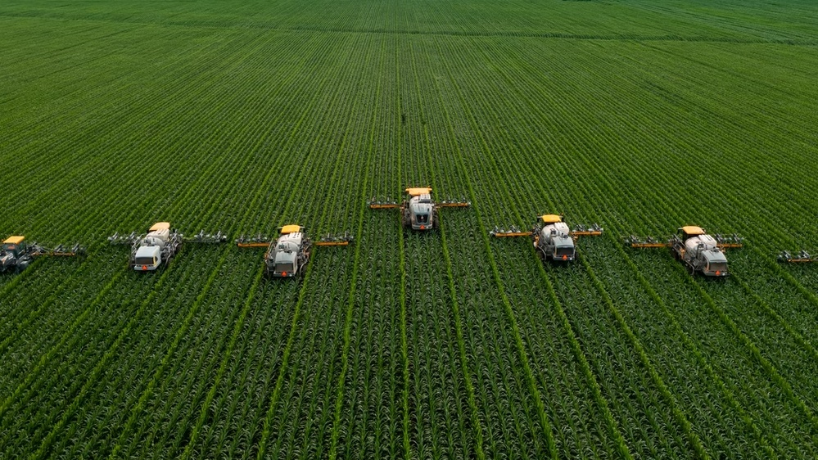

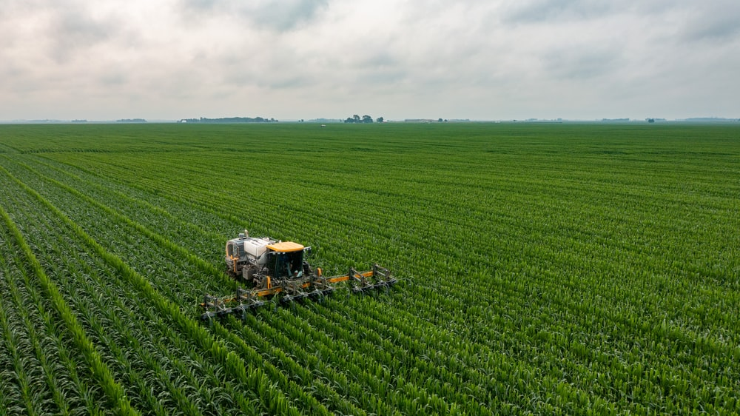

SMART AGRCULTURE
01
02
02
03
04
05
06
Main Components
07
08
Notes:
https://unsplash.com/photos/jAt6cN6zl8M
https://unsplash.com/photos/YbBWmI4hZys
https://www.freepik.com/free-photo/drone-spraying-fertilizer-vegetable-green-plants-agriculture-technology-farm-automation_21544380.htm?query=drone%20farm
https://unsplash.com/photos/d7CZYeWZyzc

Slide 4

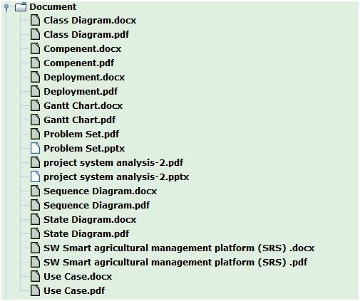
03

Slide 5
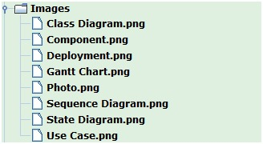


04

Slide 6
SMART AGRCULTURE
01
02
03
04
05
05
06
Build Success
07
08
Notes:
https://unsplash.com/photos/jAt6cN6zl8M
https://unsplash.com/photos/YbBWmI4hZys
https://www.freepik.com/free-photo/drone-spraying-fertilizer-vegetable-green-plants-agriculture-technology-farm-automation_21544380.htm?query=drone%20farm
https://unsplash.com/photos/d7CZYeWZyzc

Slide 7
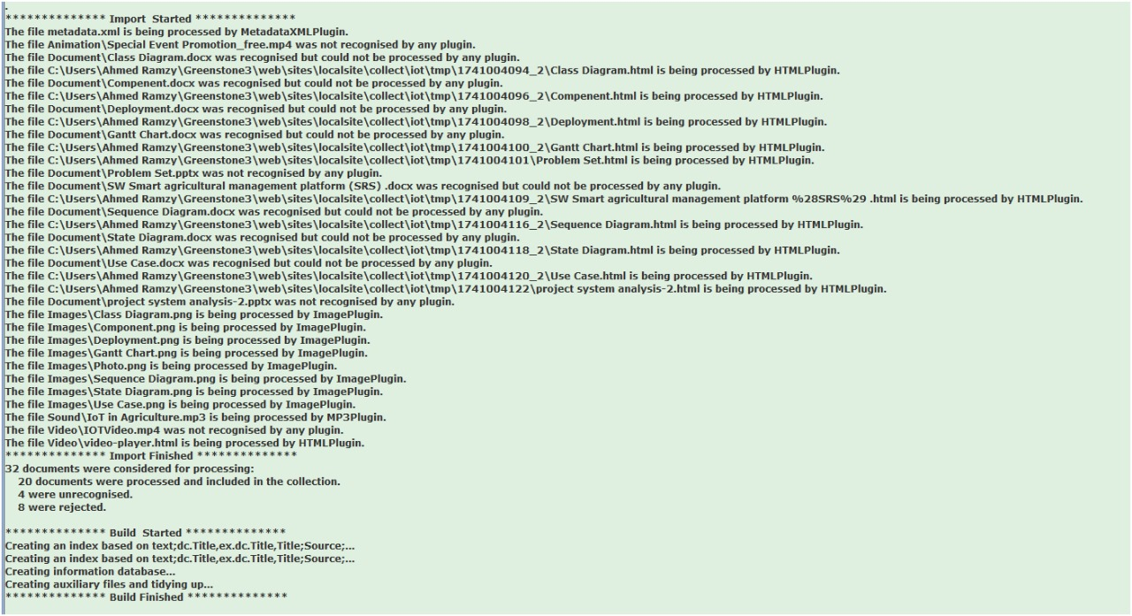
06

Slide 8
SMART AGRCULTURE
01
02
03
04
05
06
Preview in Browser
07
07
08
Notes:
https://unsplash.com/photos/jAt6cN6zl8M
https://unsplash.com/photos/YbBWmI4hZys
https://www.freepik.com/free-photo/drone-spraying-fertilizer-vegetable-green-plants-agriculture-technology-farm-automation_21544380.htm?query=drone%20farm
https://unsplash.com/photos/d7CZYeWZyzc

Slide 9
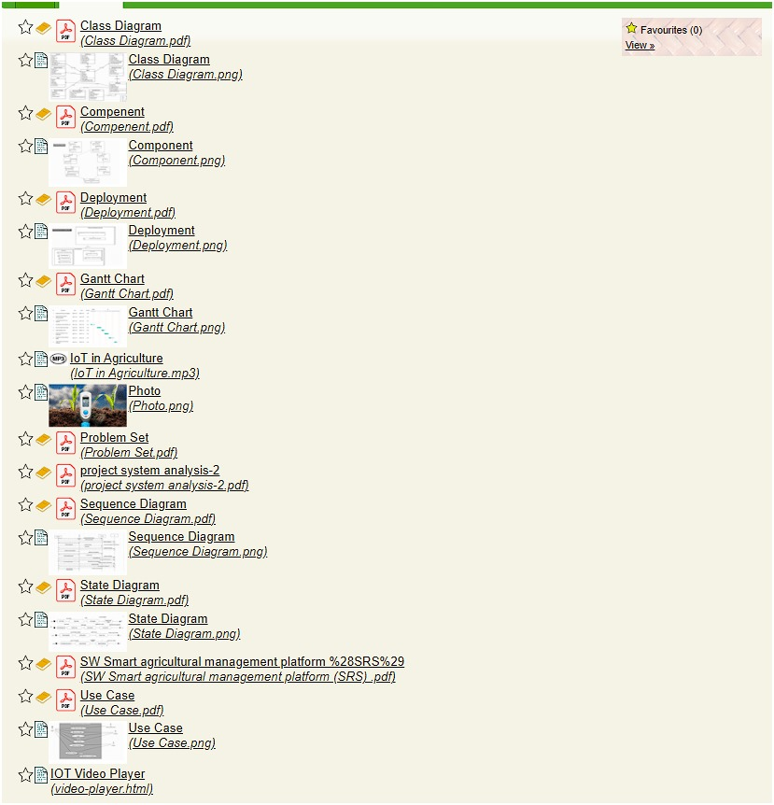
08

Slide 10
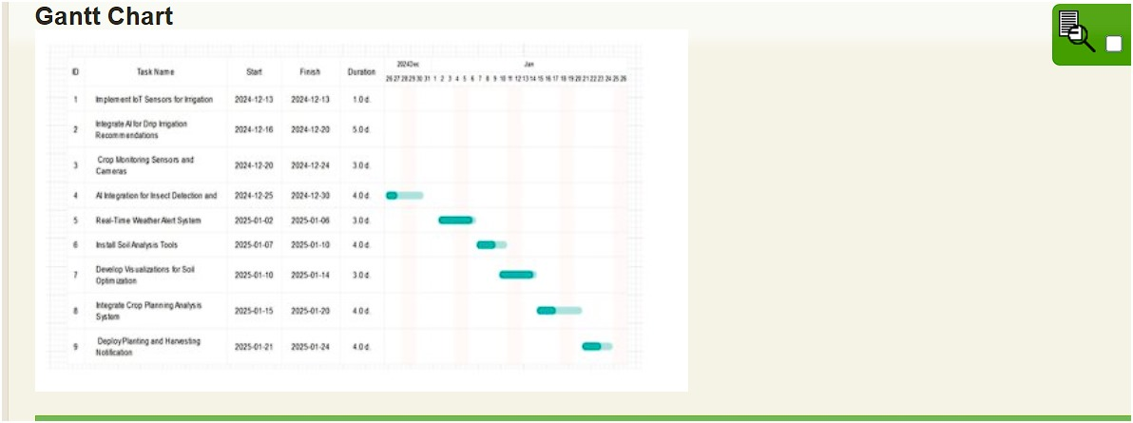

Slide 11


Slide 12
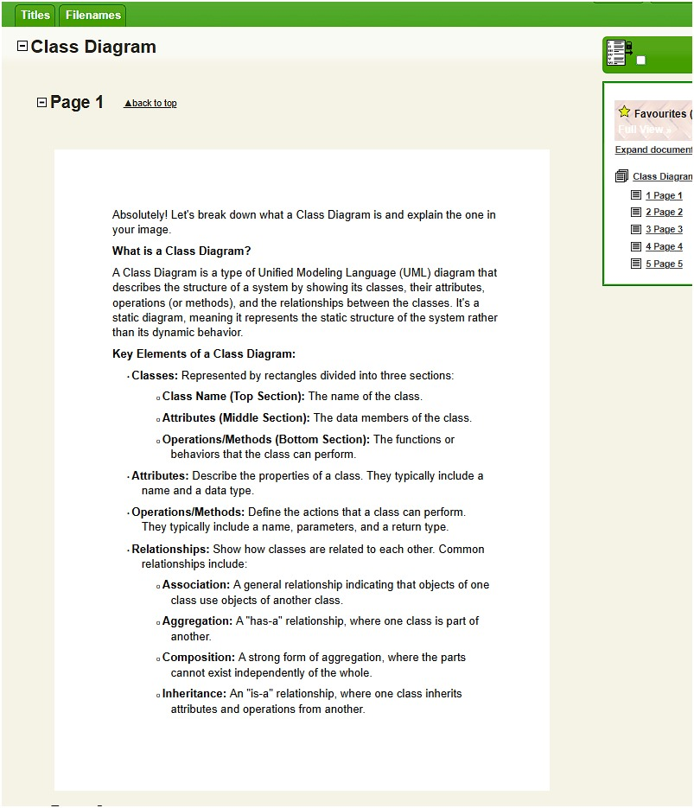

Slide 13
Team Members
Khalid Elabd.
Ahmed Ramzy.
Moustafa Ashraf.
Yousef Rehan.
Wafaa Gamal.
Marwa Sami.
Notes:
Stock photo from Powerpoint

Slide 14
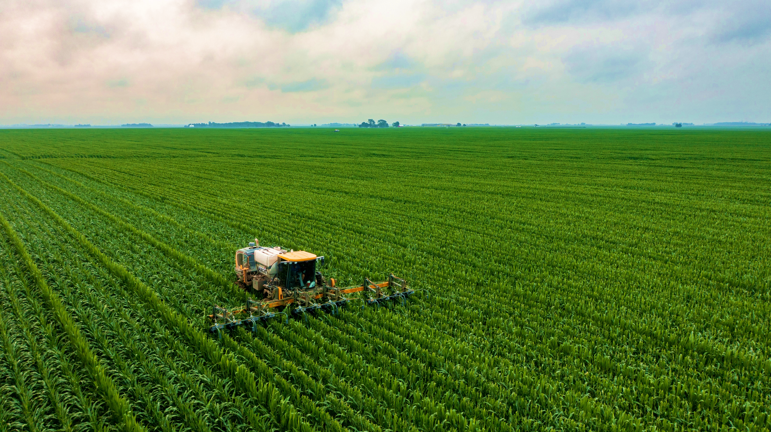

CONTACT US
www.agricultural.com
www.agricultural.com
www.agricultural.com
Notes:
Photo by James Baltz on Unsplash
https://unsplash.com/photos/d7CZYeWZyzc
Photo by Venti Views on Unsplash

